Slide 1

Parts and assemblies engineering Lab-1
Denis Dukhnovskiy and Olga Rod

Slide 2
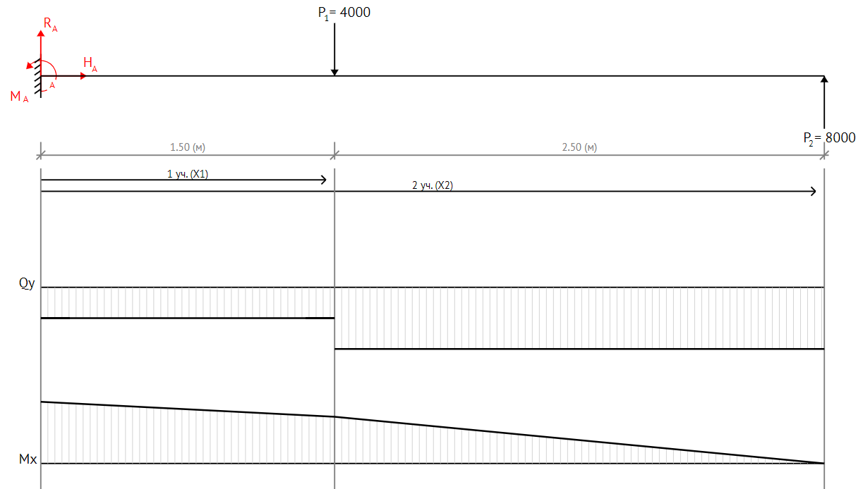
The task
Design variants of cantilever beam, which will accept the load P [N] having length L [mm].
Р1
Р2

Slide 3
Goals of task
The goal is to create a design that meets the requirements of operation and has the necessary level of quality.
Requirements of operation – Structural strength and rigidity, operational manufacturability
Quality - weight of the structure, manufacturability

Slide 4
Task guide
1. Select material and choose an allowable
2. Assume the geometry for variant
3. Step-by-step:
3.1. Design the cap of spar
3.2. Find the cross-section area
3.3. Check the Static safety factor
3.4. Local buckling for cap of spar
3.5. Design web of spar
3.6. Check the Static safety factor for web
3.7. Local buckling of web without stiffeners
3.8. Local buckling of web with stiffeners
3.9. Calculate the safety factor
4. Report of task

Slide 5
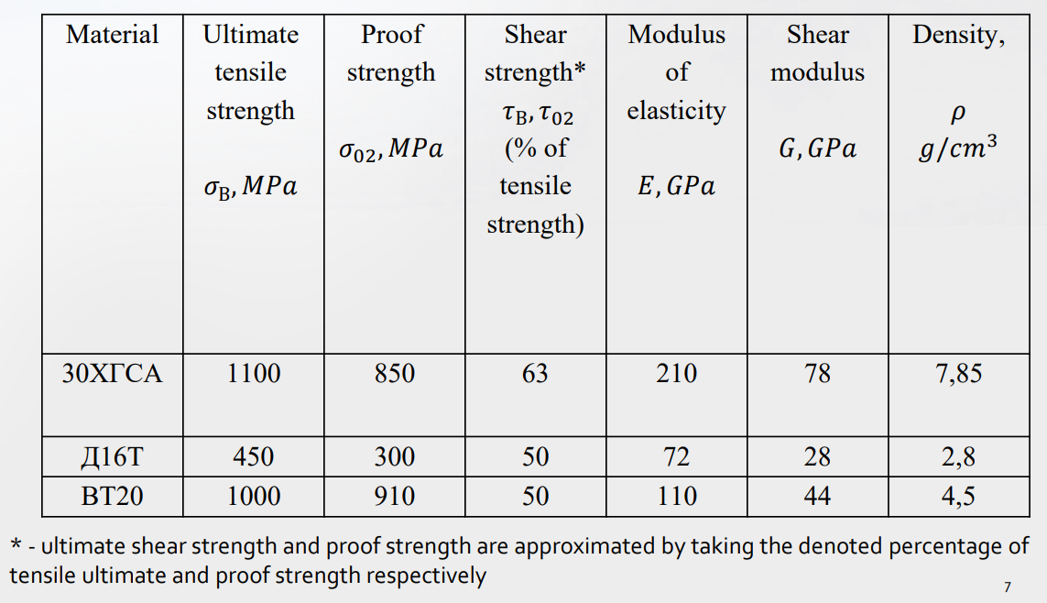
Task guide
Select material and choose an allowable:
Table – Material Properties

Slide 6

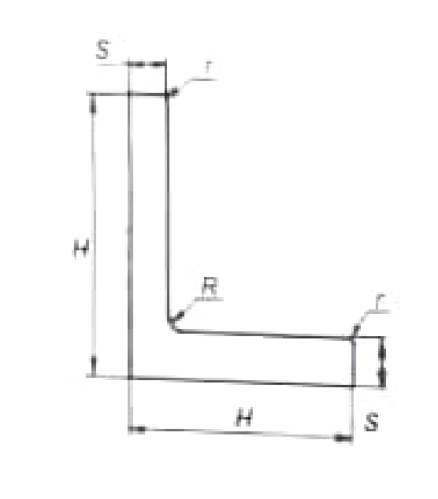
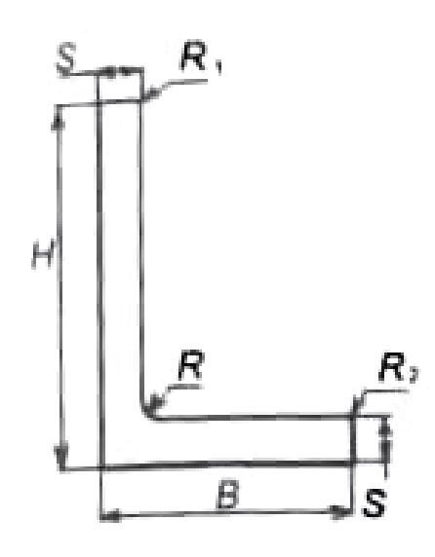
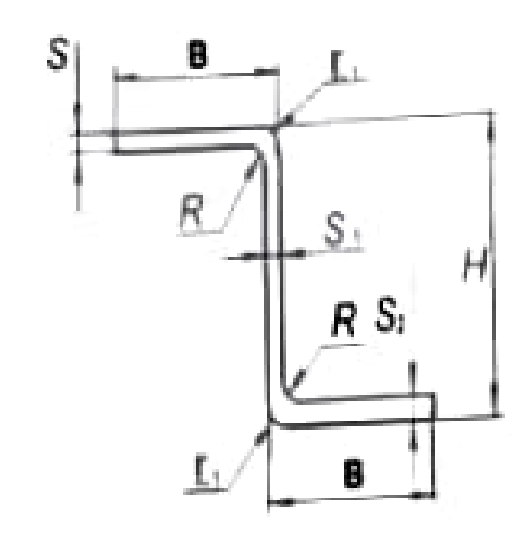
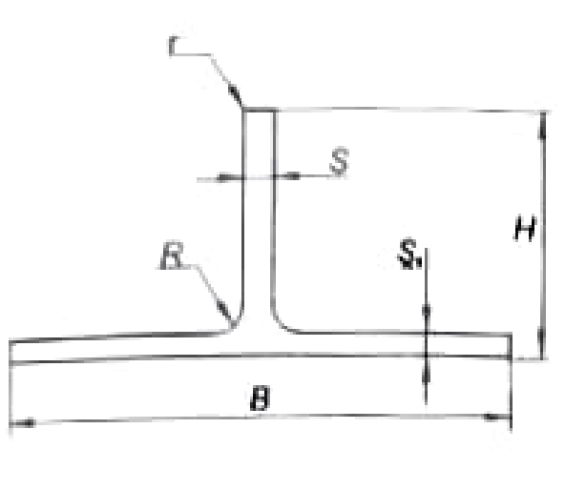
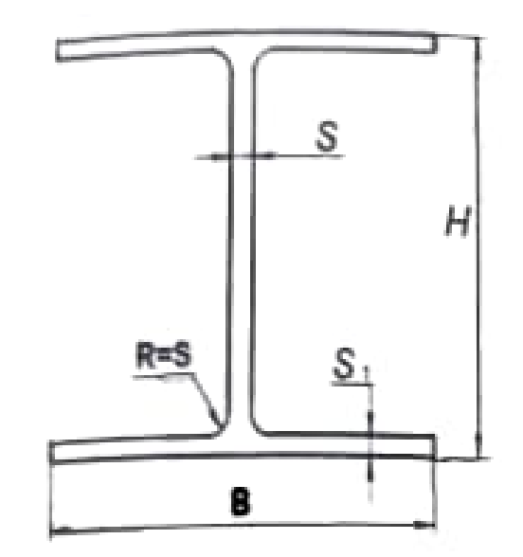

Task guide
Link for section data, variants and PPT
2. Assume the geometry for variant GOST for any type of cross-section (file-excel)
Build-up
$$H_{eq}$$
δ

Slide 7
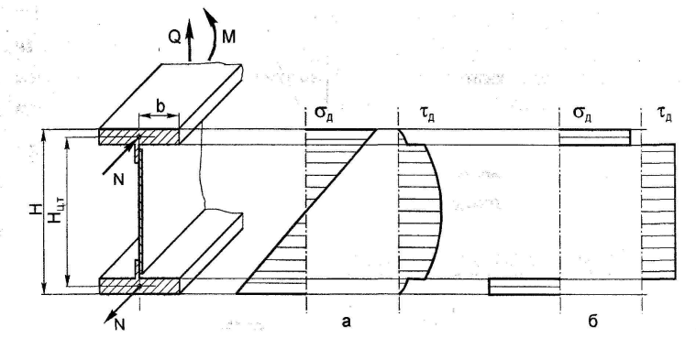
Task guide
Method of determine the shear stress and normal stress
First method for strength calculation
Second method for engineering design calculation

Slide 8

Step-by-step
F=Q for web
Q_{B-B}
Q_{A-A}
Q_{C-C}
M_{B-B}
M_{C-C}
M_{A-A}
$\text{F}=\frac{M}{H_{eq}}$ for cap
B-B
A-A
Calculate section for three case A-A, B-B and C-C
C-C

Slide 9
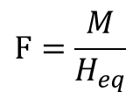
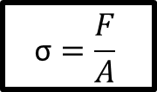


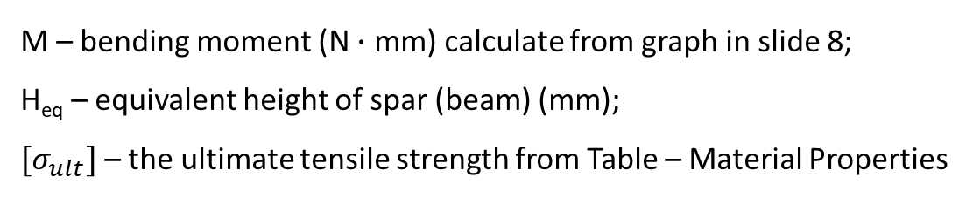
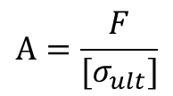
Step-by-step
3.1. Design the cap of spar
Example of Build-up cross-section
Calculation of cap area
F – force (N)
A – section area (mm²)
$$\text{σ}=\frac{F}{A}$$
$$H_{eq}$$
$$\text{A}=\frac{F}{{[σ}_{ult}]}$$
$$\text{F}=\frac{M}{H_{eq}}$$
$$H_{eq}={0,95∙H}_{spar}$$
M – bending moment (N $∙$ mm) calculate from graph in slide 8;
H_{eq} – equivalent height of spar (beam) (mm);
${[σ}_{ult}]$ – the ultimate tensile strength from Table – Material Properties
δ

Slide 10
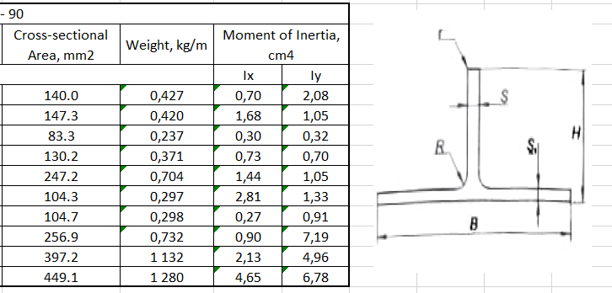

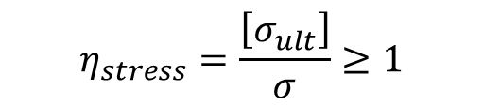
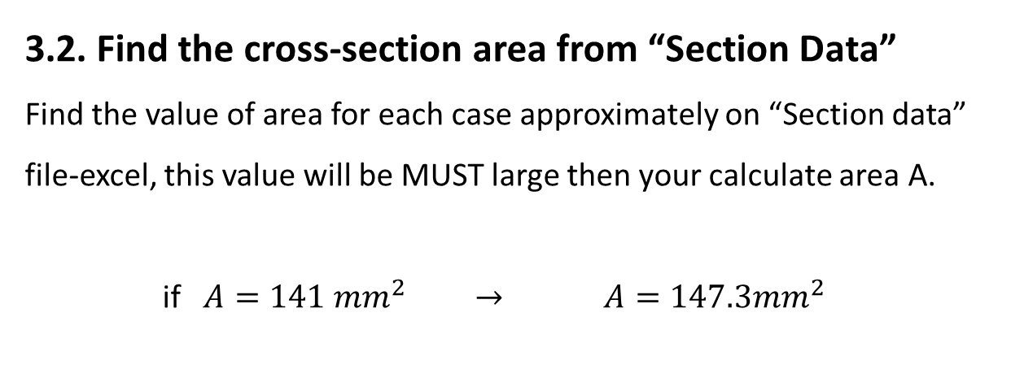
Step-by-step
3.2. Find the cross-section area from “Section Data”
Find the value of area for each case approximately on “Section data” file-excel, this value will be MUST large then your calculate area A.
if $A=141 {mm}^{2} →$ $A=147.3{mm}^{2}$
Calculate the normal stress with found area:
$$\text{σ}=\frac{F}{A}$$
3.3. Check the Stress safety factor:
If the safety factor is less then 1, it’s necessary to change the cross-section area and repeat calculation;
$$η_{stress}=\frac{\left[σ_{ult}\right]}{σ}≥1$$
!

Slide 11

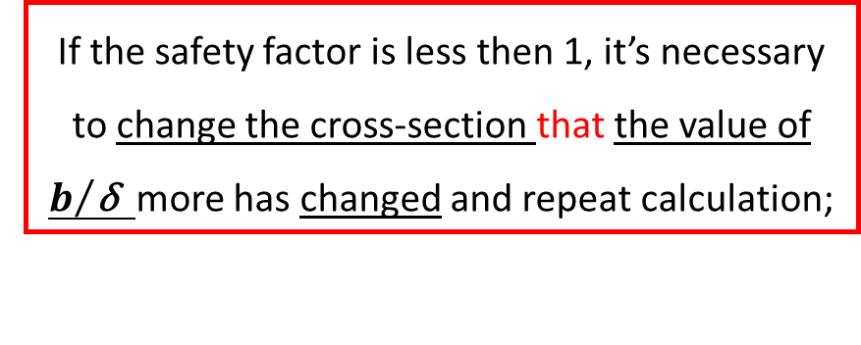
Step-by-step
Value of b for T-cross section
3.4. Local buckling for cap of spar:
$${\text{σ}}_{loc}=\frac{0,9kE}{{(b/{\text{δ})}}^{2}}, k≈0.45$$
Calculate the safety factor for cap:
$$η_{buckling}=\frac{{\text{σ}}_{loc}}{σ}≥1$$
where $σ$ is action stress on cap
b
δ
If the safety factor is less then 1, it’s necessary to change the cross-section that the value of $b/{\text{δ}}$ more has changed and repeat calculation;
!

Slide 12


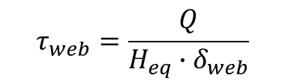

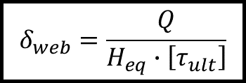

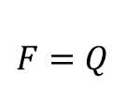


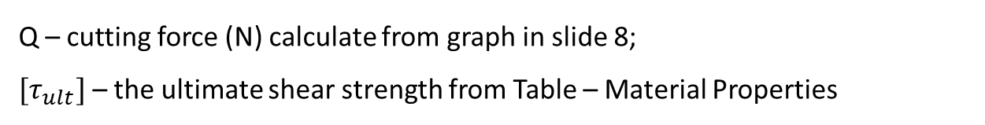
Step-by-step
Example of cross-section
$$τ_{web}$$
Q
3.5. Design web of spar
Calculate the thickness of web
$$H_{eq}$$
$$τ_{web}$$
$$τ_{web}$$
L – length of spar
$$τ_{web}=\frac{F}{A_{web}}$$
δ
$$A_{web}= H_{eq}{∙δ}_{web}$$
$$τ_{web}=\frac{Q}{H_{eq}{∙δ}_{web}}$$
$$δ_{web}=\frac{Q}{H_{eq}∙\left[τ_{ult}\right]}$$
$$F=Q$$
Q – cutting force (N) calculate from graph in slide 8;
${[τ}_{ult}]$ – the ultimate shear strength from Table – Material Properties

Slide 13
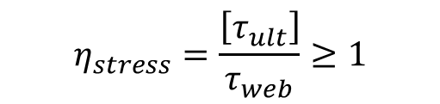
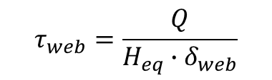
Step-by-step
3.6. Check the Stress safety factor for web:
If the safety factor is less then 1, it’s necessary to change the thickness of web and repeat calculation;
$$η_{stress}=\frac{\left[τ_{ult}\right]}{τ_{web}}≥1$$
!
Calculate the shear stress with new thickness of web:
$$τ_{web}=\frac{Q}{H_{eq}{∙δ}_{web}}$$

Slide 14
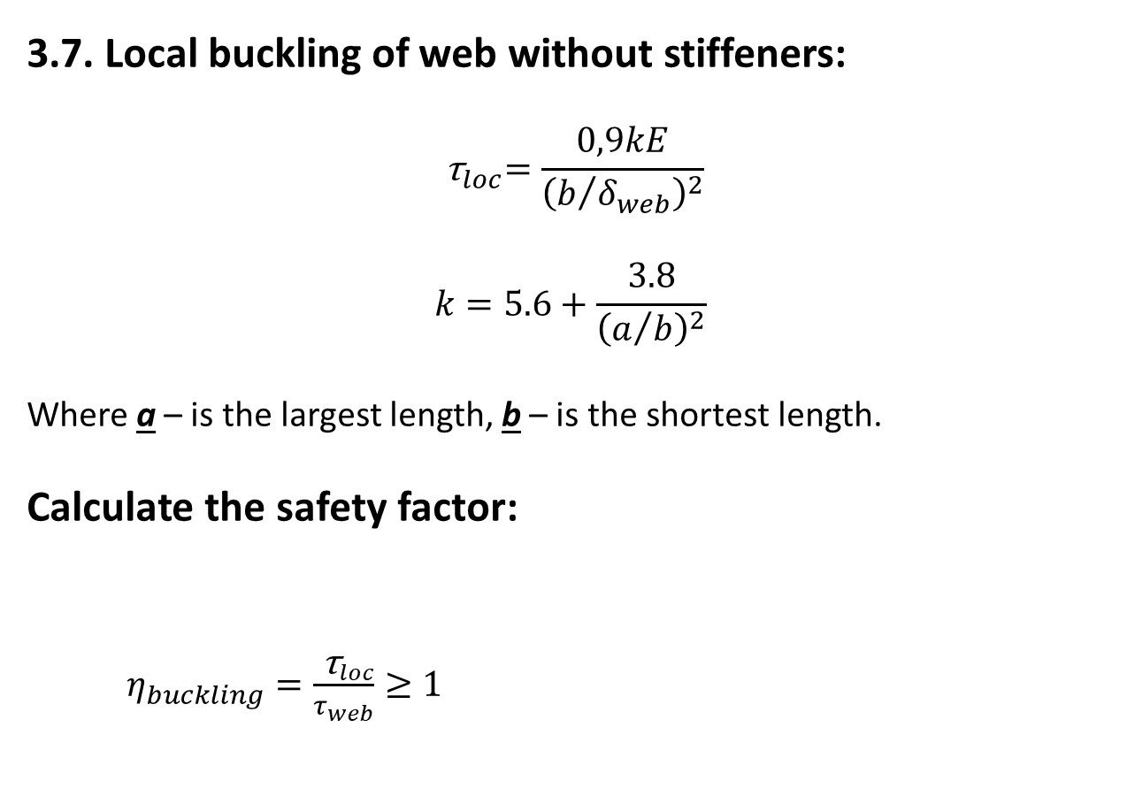



Step-by-step
Q
3.7. Local buckling of web without stiffeners:
$${ \text{τ}}_{loc}=\frac{0,9kE}{{\left(b/{δ_{web}}\right)}^{2}}$$
$$k=5.6+\frac{3.8}{{\left(a/b\right)}^{2}}$$
Where a – is the largest length, b – is the shortest length.
Calculate the safety factor:
$η_{buckling}=\frac{{ \text{τ}}_{loc}}{τ_{web}}≥1$
$$τ_{web}$$
$$H_{eq}$$
$$τ_{web}$$
L – length of spar
a = L
b = H_{eq}
(for case web without stiffeners)
!
If the safety factor is less then 1, it’s necessary to read a rules of design web (next slide);

Slide 15

Step-by-step
Rules for design web of spar:
If $η_{buckling}≥1$ – it is OK, the parameters of web is well
If $0.6{<η}_{buckling}<1$ – it is necessary to add some stiffeners
If $η_{buckling}<0.6$ – it is necessary to increase the thickness of web and calculate $η_{stress}$and $η_{buckling}$ again

Slide 16
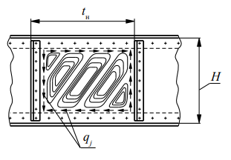
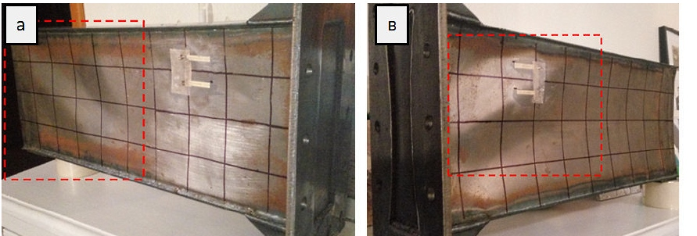
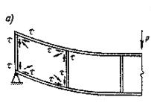
Step-by-step
Local buckling web
Web without stiffeners
Web with stiffeners

Slide 17
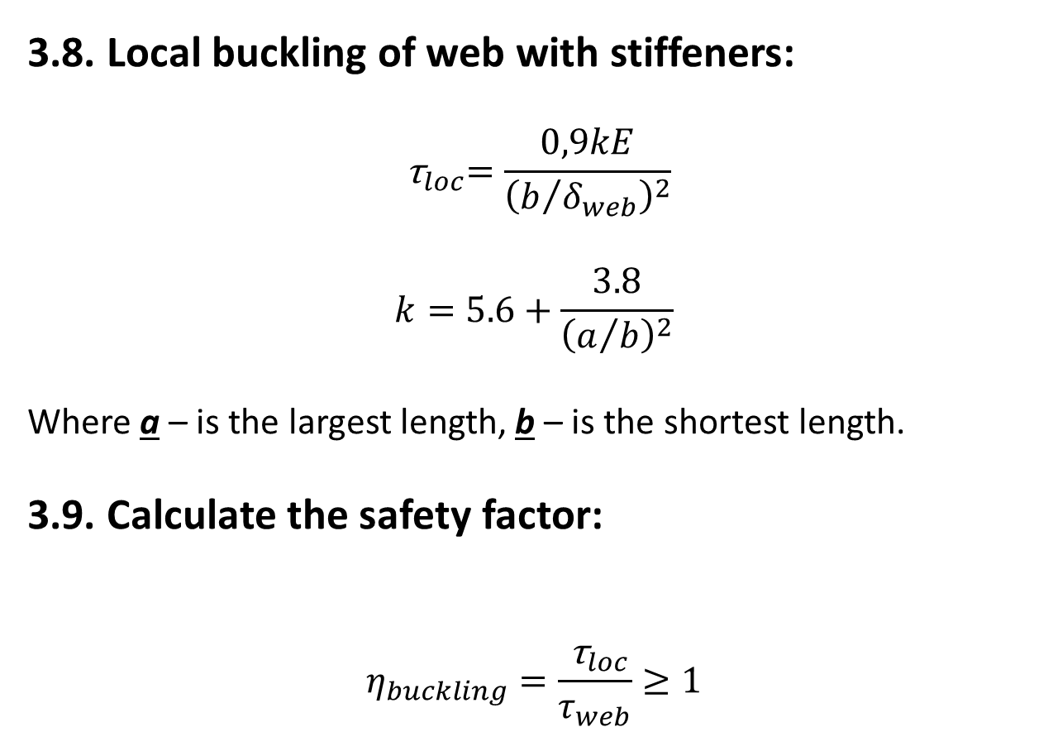


Step-by-step
Q
a
$$τ_{web}$$
3.8. Local buckling of web with stiffeners:
$${ \text{τ}}_{loc}=\frac{0,9kE}{{\left(b/{δ_{web}}\right)}^{2}}$$
$$k=5.6+\frac{3.8}{{\left(a/b\right)}^{2}}$$
Where a – is the largest length, b – is the shortest length.
3.9. Calculate the safety factor:
$$η_{buckling}=\frac{{ \text{τ}}_{loc}}{τ_{web}}≥1$$
b
Web with three stiffeners
Q
b
$$τ_{web}$$
a
Web with two stiffeners

Slide 18

Step-by-step
Q
a
$$τ_{web}$$
If ${\text{τ}}_{loc}>{\text{τ}}_{yield}$
$${\text{τ}}_{loc}=\left[τ_{ult}\right]\frac{1+ψ}{1+ψ+ψ^{2}}$$
$$ψ=\frac{\left[τ_{ult}\right]}{{\text{τ}}_{cr}} where{ \text{τ}}_{cr}=\frac{0,9kE}{{\left(b/{δ_{web}}\right)}^{2}}$$
And Calculate the safety factor:
$$η_{buckling}=\frac{{ \text{τ}}_{loc}}{τ_{web}}≥1$$
b
Web with three stiffeners
Q
b
$$τ_{web}$$
a
Web with two stiffeners

Slide 19
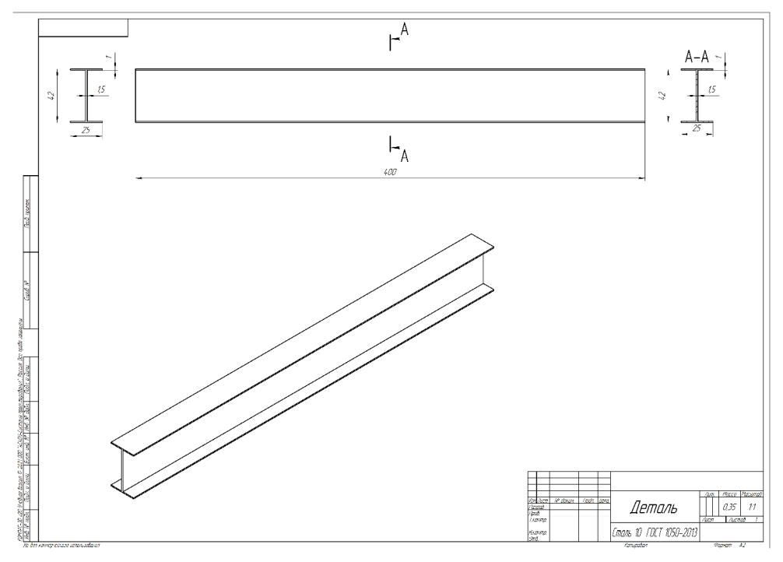
Task guide
4. Report of Lab work-1 Draw the graph of transverse force and moment
For different cross-section make the stress analysis Draw the section with best variant from stress analysis

